Slide 1
Capstone Engagement
Assessment, Analysis, and Hardening of a Vulnerable System

Slide 2
Table of Contents
This document contains the following sections:
01
Network Topology
02
Red Team: Security Assessment
03
Blue Team: Log Analysis and Attack Characterization
Hardening: Proposed Alarms and Mitigation Strategies
04

Slide 3
Network Topology
3

Slide 4
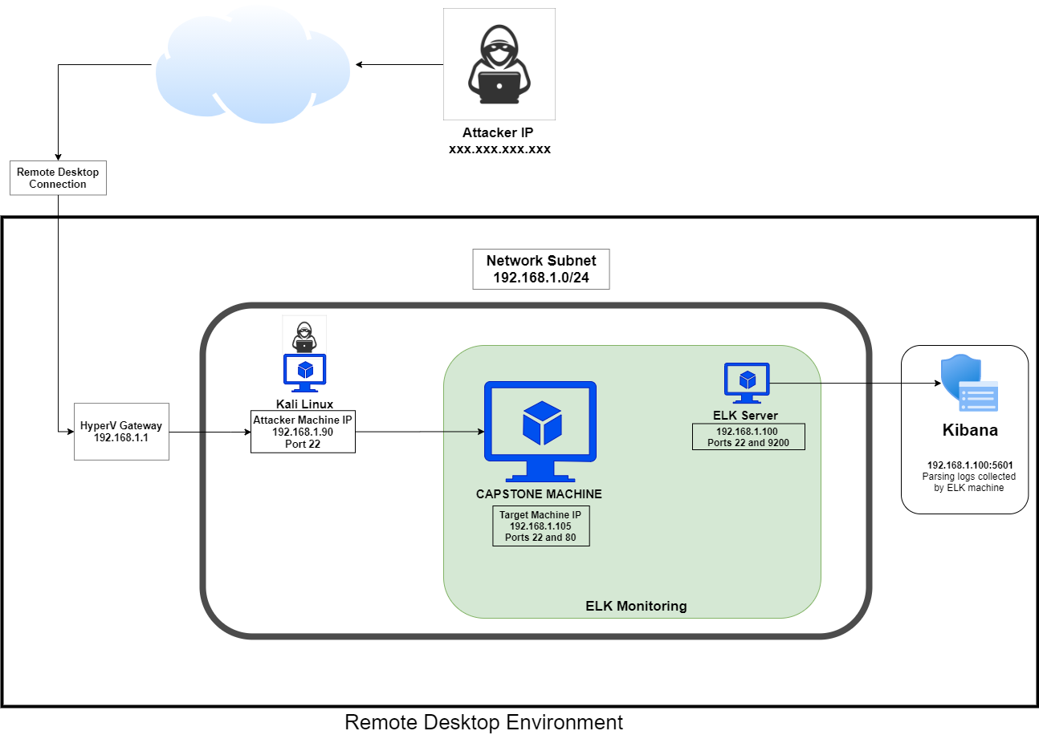
Network Topology
Network
Address Range:
192.168.1.0/24
Netmask:
255.255.255.0
Gateway: 192.168.1.1
Machines
IPv4: 192.168.1.1
Hostname: Gateway
OS: Windows 10 Pro
IPv4: 192.168.1.105
Hostname: Capstone
OS: Linux
IPv4: 192.168.1.90
Hostname: Kali Linux
OS: Linux
IPv4: 192.168.1.100
Hostname: ELK Server
OS: Linux

Slide 5
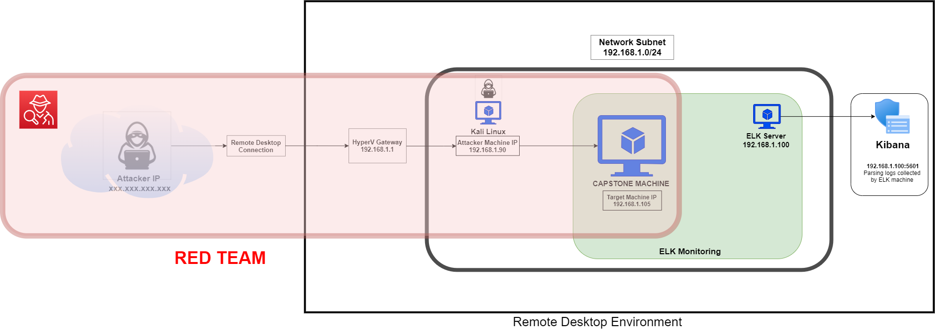
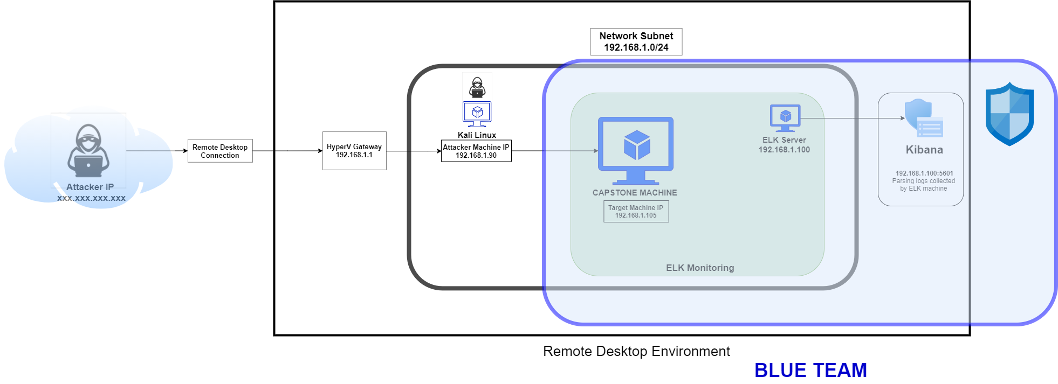

Slide 6

Red Team
Security Assessment
6

Slide 7
Recon: Describing the Target
Nmap identified the following hosts on the network:
Hostname | IP Address | Role on Network
Gateway | 192.168.1.1 | Virtual Network Host – with Hyper-V
Capstone | 192.168.1.105 | Target Machine
Kali Linux | 192.168.1.90 | Penetration Testing Machine
ELK Server | 192.168.1.100 | Monitoring and Logging Machine

Slide 8
Vulnerability Assessment
The assessment uncovered the following critical vulnerabilities in the target:
Vulnerability | Description | Impact
Directory Listing Vulnerability CWE-548: Exposure of Information Through Directory Listing | The directory structure is visible and accessible from a browser without any passwords. | Attackers can try many attacks from this access, and some documents with sensitive data are carelessly left available from there.
SQL Injection Vulnerability | This type of SQLI vulnerability potentially allows attackers to input malicious codes and queries from the browser search bar to the accessible directories. | This vulnerability may provide attackers access to the system and uncover credentials, and even deliver malicious payloads.
Usernames in plaintext CWE-312: Cleartext Storage of Sensitive Information CWE-256: Unprotected Storage of Credentials CWE-522: Insufficiently Protected Credentials | Usernames printed in regular text and unprotected for the public to discover in the webserver. Usernames should never be provided to the public. | Attackers can use usernames to direct bruteforce attacks directly to those names, making bruteforce attacks massively more efficient.

Slide 9
Vulnerability Assessment
Vulnerability | Description | Impact
Uploading of malicious script CWE-434: Unrestricted Upload of File with Dangerous Type | Webdav is enabled, allowing attackers to upload malicious script to the server. | Amongst many possible attacks, attackers can use this vulnerability to launch a reverse shell and gain access to the system.
Unencrypted documents CWE-311: Missing Encryption of Sensitive Data | Unencrypted text documents with sensitive data are openly viewable on the webserver. | Unencrypted text documents on the webserver provide usernames, job titles and the location of a hidden directory. Attackers can use this to quickly locate sensitive data and breach the system.
Weak user names. | Usernames are identical to management staff names and can easily be discovered through Google Dorking. | Having accurate usernames makes bruteforce attacks far more efficient; staff names can be added to a list for bruteforce attacks. Usernames must be confidential and difficult to guess.

Slide 10
Vulnerability Assessment
Vulnerability | Description | Impact
CWE-256: Unprotected Storage of Credentials | One user’s credential – password hash, was available in a text document through the webserver once basic access was achieved. A password hash should never be made public. | Printing a password hash in a publicly available document is a critical vulnerability, which will assist attackers in gaining access to the system, in this case, easy access.
CWE-759: Use of a One-Way Hash without a Salt | Ryan’s password has was a simple md5 hash without a salt, making it very easy to decrypt. | Having unsalted password hashes makes it very easy for attackers to decrypt, gain credentials and gain access.
CWE-916: Use of Password Hash With Insufficient Computational Effort | Ryan’s password hash uses md5 encryption. The md5 encryption algorithm is outdated and suffers from extensive vulnerabilities. | A simple md5 hash may be decrypted within seconds, providing passwords to attackers with little effort.

Slide 11
Vulnerability Assessment
Vulnerability | Description | Impact
CWE-521: Weak Password Requirements | Passwords are too easy with a low level of complexity. The 2 discovered were a simple phrase and a name. Minimum requirements include - 8 characters with a mixture of: upper and lower case, numbers and special characters. | Weak passwords are easy to uncover through bruteforce and dictionary attacks.
CVE-2017-15710 | A particular header value is searched for and if it is not present in the charset conversion table, it reverts to a fallback of 2 characters (eg. en-US becomes en). While this risk is unlikely, if there is a header value of less than 2 characters, the system may crash. | This vulnerability has the potential to force a Denial of Service attack

Slide 12
Vulnerability Assessment
Vulnerability | Description | Impact
CVE-2018-1312 | When generating an HTTP Digest authentication challenge, the nonce sent to prevent reply attacks is not correctly generated using a pseudo-random seed. | With this vulnerability, an attacker would be able to replay HTTP requests across a cluster of servers, avoiding detection.
CVE-2018-1312 | When generating an HTTP Digest authentication challenge, the nonce sent to prevent reply attacks is not correctly generated using a pseudo-random seed. | With this vulnerability, an attacker would be able to replay HTTP requests across a cluster of servers, avoiding detection.
CVE-2017-1283 | Mod_session is configured to forward its session data to CGI applications | With this vulnerability, a remote user may influence their content by using a "Session" header.

Slide 13
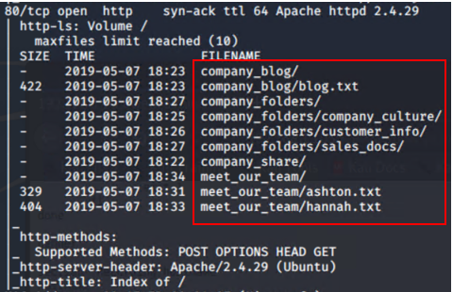
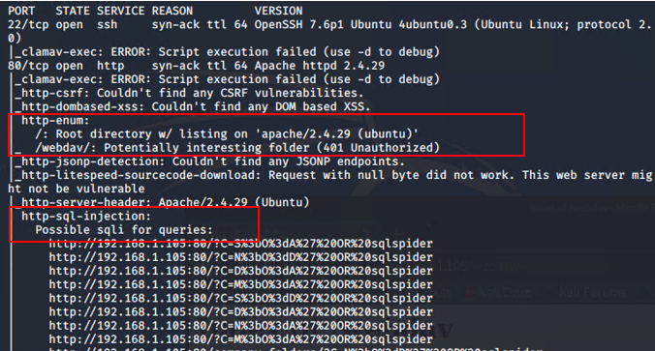
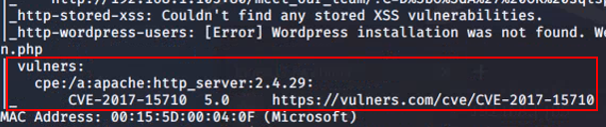
Vulnerability Assessment

Slide 14
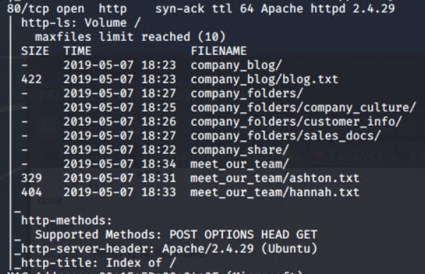
Exploitation: Directory Listing Vulnerability - CWE-548
01
02
03
Tools & Processes
Nmap
Using Nmap, the webserver directory structure was revealed.
Browser
Using a browser, simply navigating the directory structure from the IP address revealed enough information to eventually breach the system.
Achievements
Provided access to documents that yielded three usernames to be used for a bruteforce attack, as well as the location of a hidden directory, all of which will eventually yield two passwords. The secret folder will require ashton’s password, which will be the first target for bruteforcing.
Nmap

Slide 15
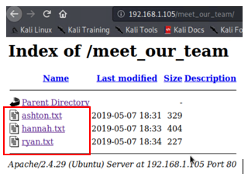
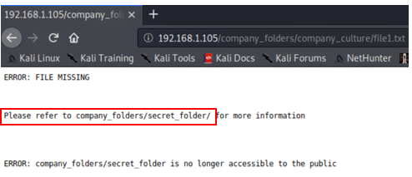
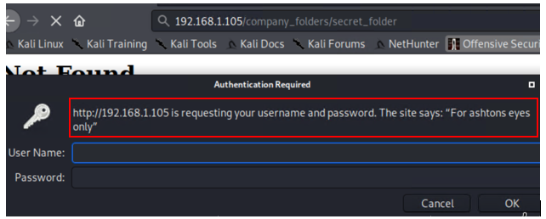
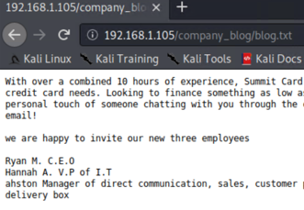
Exploring the webserver

Slide 16
Exploitation: Weak password - CWE-521
01
02
Tools & Processes
Hydra
Hydra was used to bruteforce ashton’s username against the webserver’s password protected area.
hydra -l ashton -P /opt/rockyou.txt -s 80 -f -vV 192.168.1.105 http-get "/company_folders/secret_folder"
Achievements
This attack provided ashton’s password, which was a simple name – leopoldo.
These credentials provided:
Access to the hidden directory in the webserver. This revealed a document that contained instructions to connect to webdav with the CEO’s username and password hash.
SSH entry into system. This provided access to Ashton’s files and the first flag.txt

Slide 17
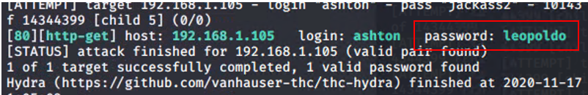
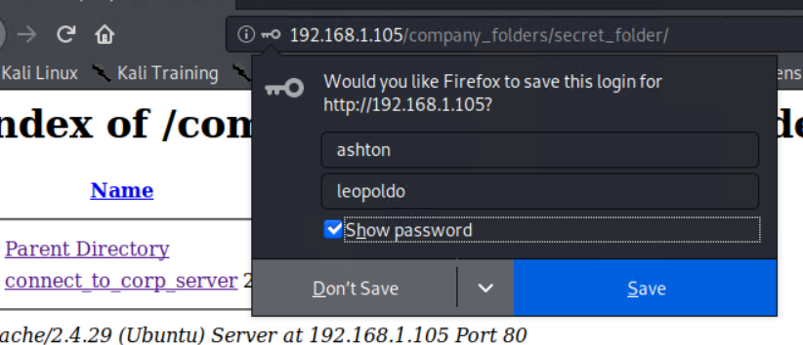
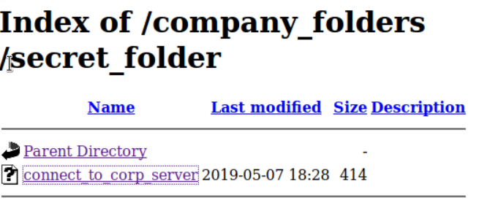
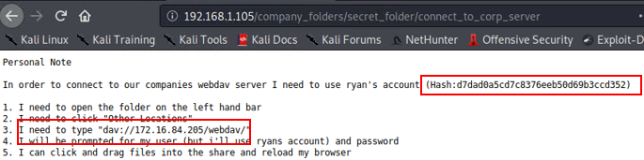
03
Hydra bruteforce
Accessing the Hidden directory

Slide 18
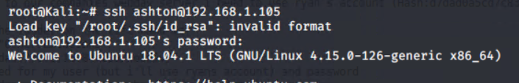
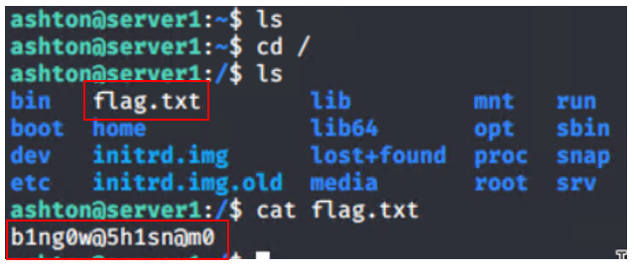
SSH into Ashton’s account

Slide 19
Exploitation: Weak hash - CWE-759, CWE-916
01
02
Tools & Processes
Crackstation
Using this online tool, the hash was simply entered into the online tool and cracked in seconds.
Achievements
This provided the password for the CEO – linux4u
This attack yielded access to webdav and the ability to upload a malicious script that would eventually provide a reverse shell.

Slide 20
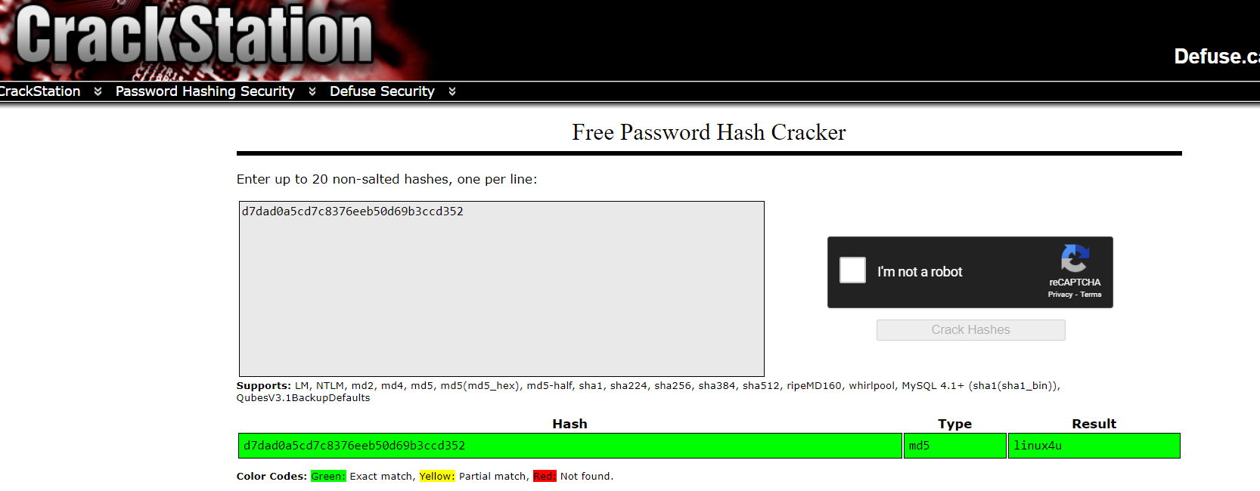
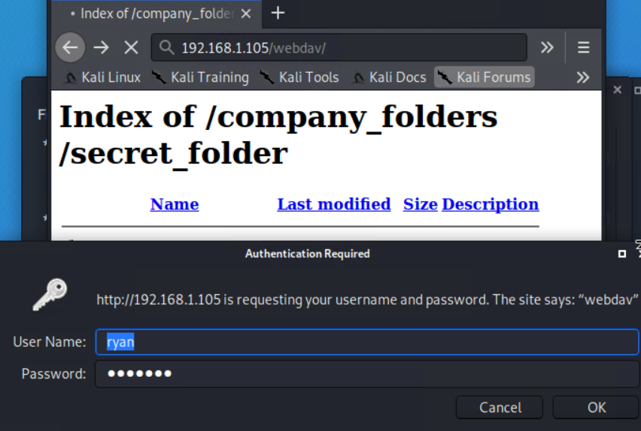
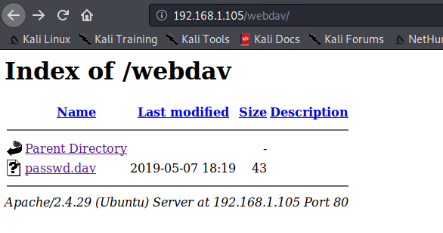
03
Cracking Ryan’s hash
Accessing webdav

Slide 21
Exploitation: Uploading of malicioius script - CWE-434
01
02
Tools & Processes
Msfvenom – created the malicious script – shell.php
Cadaver – uploaded the payload to the webdav directory.
Metasploit – started a listener, which then launched a meterpreter session once the shell.php was run on the webserver.
Interactive shell with python -
python -c 'import pty; pty.spawn("/bin/bash")'
Achievements
Using a reverse shell, opened a meterpreter session in the target system, and achieved an interactive shell for user: www-data
Located and exfiltrated the second flag.txt

Slide 22
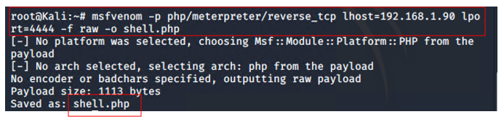
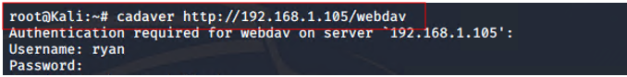
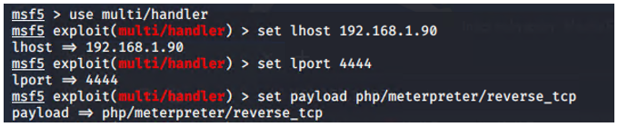
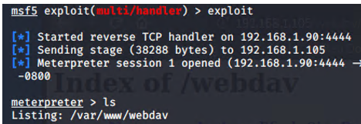
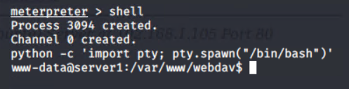
03
Creating the payload
Uploading the payload
Launching the listener
Gaining interactive shell

Slide 23
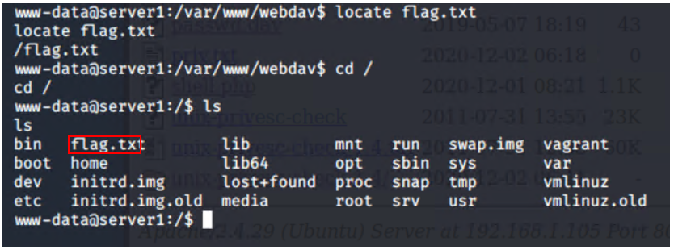
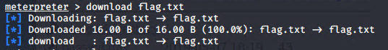
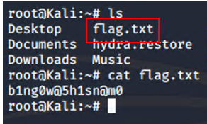
Locating and exfiltrating target document

Slide 24

Blue Team
Log Analysis and Attack Characterization
24

Slide 25

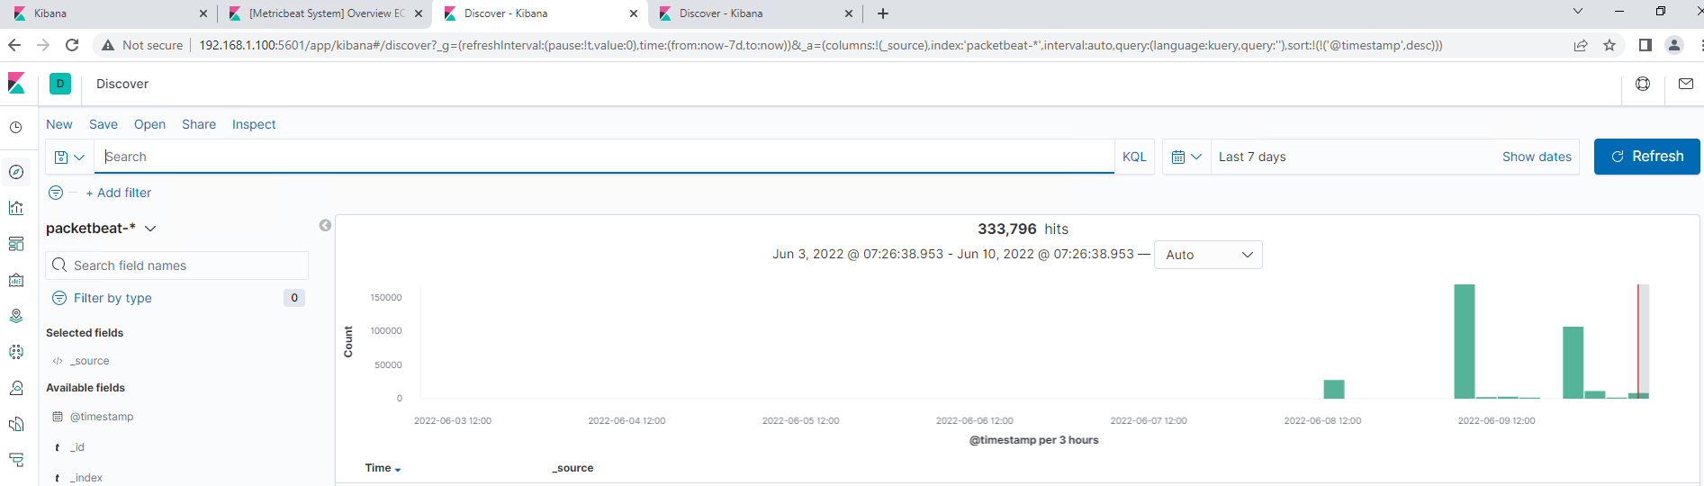
Analysis with Kibana: Identifying the Port Scan

Slide 26
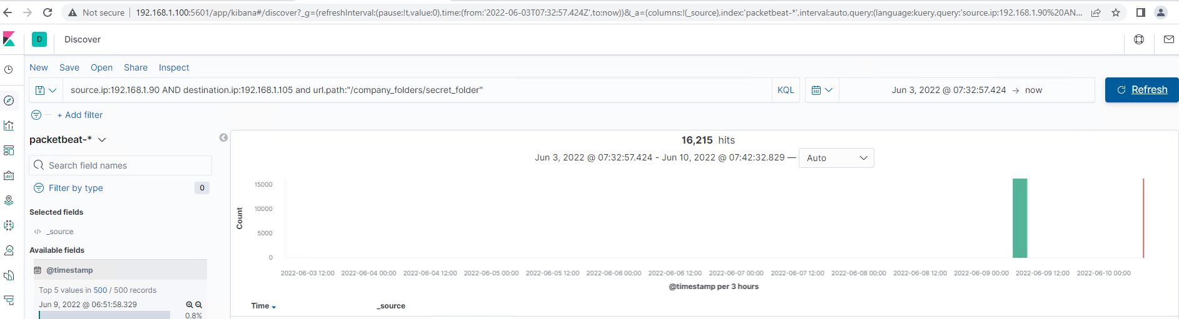
Analysis: Finding the Request for the Hidden Directory

Slide 27
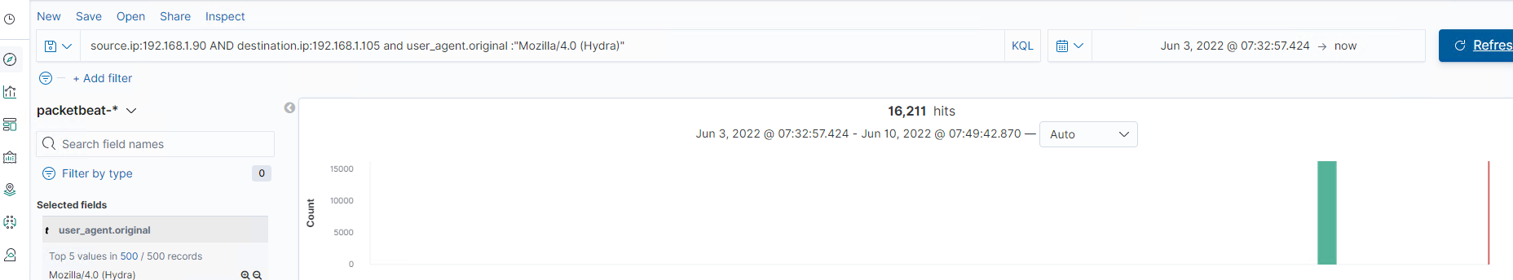
Analysis: Uncovering the Brute Force Attack

Slide 28
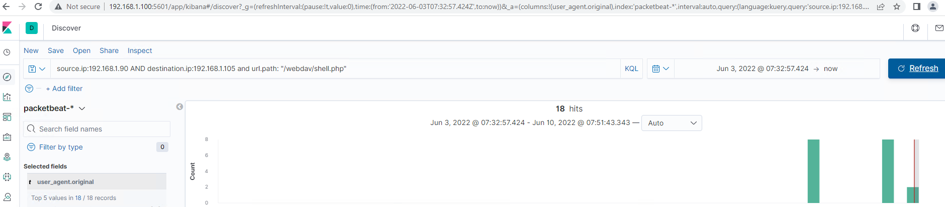
Analysis: Finding the WebDAV Connection

Slide 29
Blue Team
Proposed Alarms and Mitigation Strategies
29

Slide 30
Mitigation: Blocking the Port Scan
Though useful, having alerts for every port scan is unrealistic.
Setup a low-level alert for any port scanning, with a threshold of 10, and a severe alert for anything above 100.
Have alerts for any use of Nmap.
Setup a critical alert for aggressive scans.
Whitelist known IPs and have the firewall block unauthorised IPs from scanning.
Schedule regular security checks on all ports. Close ports that don’t need to be open. Keep all services running in ports updated.
Review IDS regularly, obfuscate and limit returned information, block the probes and host sweeps, rate-limit and slow down scans to thwart scan attempts and scan results.

Slide 31
Mitigation: Finding the Request for the Hidden Directory
Set a timeout of 30min+ for more than 3 password failures, and that time increases with every failure. Blacklist the IP after 10 failed password attempts.
Increase password strength requirements to the directory (minimum length, mixture of upper case, lower case, numbers and special characters).
Force a password reset every 3 months.
For privileged accounts create multi-factor authentication.
Limit user access to the directory.
Remove all reference to the hidden directory in the webserver.
Create 2 alerts.
1. A low-level alert for more than 3 password failures.
2. Create a critical alert for more than 10 failures.
Create an alert for non-whitelisted IPs attempting to access the directory.

Slide 32
Mitigation: Preventing Brute Force Attacks
For all password portals, such as the webserver and SSH, setup alerts for more than 3 failed attempts, and critical alerts for 10 failed attempts.
Setup account timeout and lockout rules for failed password attempts to block brute forcing. After 3 failures a 30min timer is triggered and increases with every successive password failure, up to 10, upon which the user account is locked, a password expiry is triggered and a critical alert is sent to the security team.
Increase password strength requirements and expiry every 3 months. Consider multi-factor authentication.
Rate-limit traffic to block mass password attempts.

Slide 33
Mitigation: Detecting the WebDAV Connection
Create an alert for non-whitelisted IPs connecting to WebDAV and from non-secure locations.
Limit user access to WebDAV.
Harden authentication to WebDAV – password requirements, MFA, whitelisting IPs.
Scanning all incoming traffic with anti-virus/anti-malware.
Update regularly.
Upgrade to a more secure application.
Consider only allowing internal access to WebDAV, within the companies building/network, block external connections.

Slide 34
Mitigation: Identifying Reverse Shell Uploads
Monitor all incoming uploads and setup an alert for anything triggered by anti-virus/anti-malware.
Create an alert for files that contain suspicious code/scripts/file extensions.
Setup a secure anti-virus/anti-malware application that screens all incoming files and automatically updates daily.
Update firewall rules.
Limit filetypes that can be uploaded, including restricting php.

